Slide 1
META Teletherapy
Mental Health Services Partner for Colleges

Slide 2
COVID has Detrimentally Impacted the College Experience
60 percent of students indicate that the pandemic has made it more difficult to access mental health care | 66 percent of students reported that the pandemic has resulted in more financial stress
46 percent of at-risk students taking online courses reported greater mental health needs | 63 percent of students would grade their college’s response to mental health and wellness services a “C” or lower
Health Minds Network & ACHA “The Impact of COVID-19 on College Student Well-Being”
“Students Struggle but Don’t Seek Colleges’ Help,” Inside Higher Education

Slide 3
The Nation’s Only College Mental Health Marketplace!
EASY, MOBILE ACCESS - The META app is free to download. Students connect to META’s licensed providers or their school’s counselors for chat, voice call and video sessions
RESPONSE TIME IN UNDER SIX HOURS - META providers are available weekdays, evenings, and weekends to all on-campus and remote students. Students can get help when they need, and your counseling staff can focus on sessions and care delivery. 1 in 3 teletherapy sessions occur before 9am and after 5 pm
EXPANDS SCHOOL SUPPORT - META augments your existing healthcare services as a scalable and cost-effective mental health solution

Slide 4
META is the Only Marketplace Solution Engaged with HBCU/PBIs
Since August 2020, 28 HBCU Institutions, with an eligible student population of 80,000, have chosen META as the teletherapy platform for their students
We support HBCU/PBIs with a variety of student populations
State Schools
Private Institutions
Graduate Schools
Schools in Rural Areas
~300 META providers across all 50 states support these students
Licensed Professional Counselors, Licensed Marriage & Family Therapists, and Licensed Clinical Social Workers

Slide 5
Why partner with META Teletherapy?
META’s Experience
META was created based on 15 years of experience working with over 1,000 campuses across the US
Built for Security, Privacy & Ease of Implementation and Use
META’s Provider Network
META provides a ratio counselor-to-student ratio of 1:250 with counselors in all 50 states
Diverse; student rating of providers is 4.9/5.0
Providers have an average response time under 6 hours (industry average is 1-3 days)
META’s Reputation
META has the endorsement from prestigious non-profit organizations such as the Thurgood Marshall College Fund, APIA Scholars, ECMC Foundation, and Kresge Foundation that are dedicated to expanding mental health access to underserved populations
70 institutions have partnered with META in the last 18 months

Slide 6
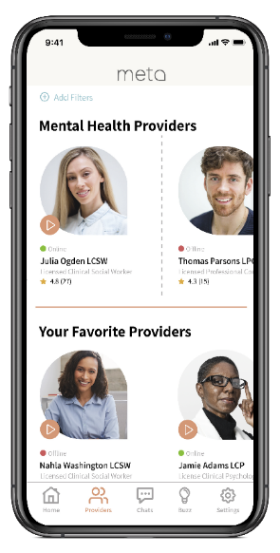
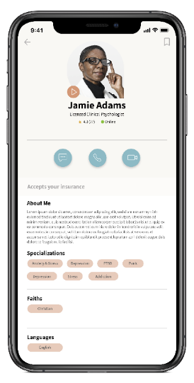
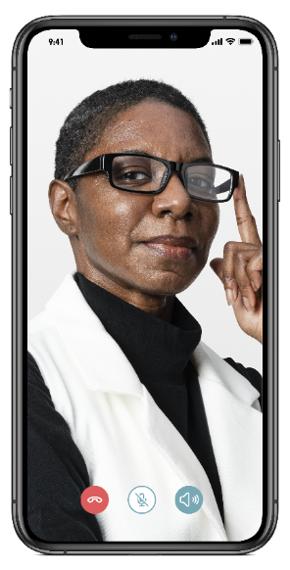
META App is Built for Students Like Yours
SEARCH
SELECT
ENGAGE
Access
Register in 2 minutes
Choice
Select campus or META counselor
Connect
Private chat, video, voice sessions

Slide 7
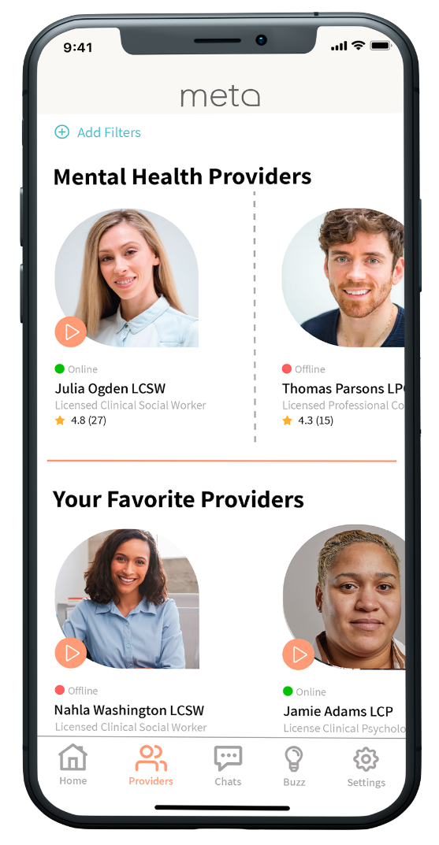
Provider Network Just for Colleges
500+ licensed professional counselors, family therapists, social workers and psychologists
All providers are personally vetted and pass thorough onboarding process
Availability during weekends and evenings; accepting new patients
Responsive and Committed
Logged 60,000 hours of online availability in 2 years
Most respond with the hour; average response time <6 hours
Average provider rating by students is 4.9/5.0
Provider options suit student needs
Multiple ethnicities, faiths, and languages represented including Black, Native American, Asian and Latino

Slide 8
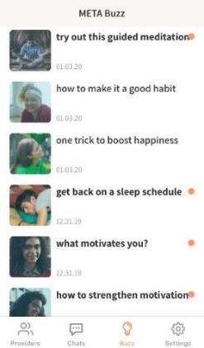
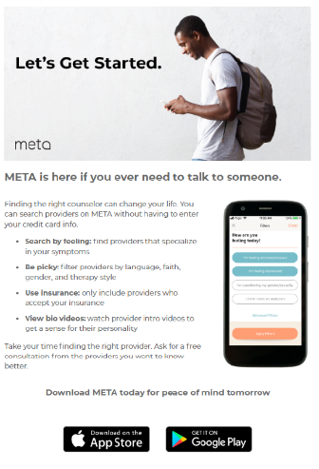
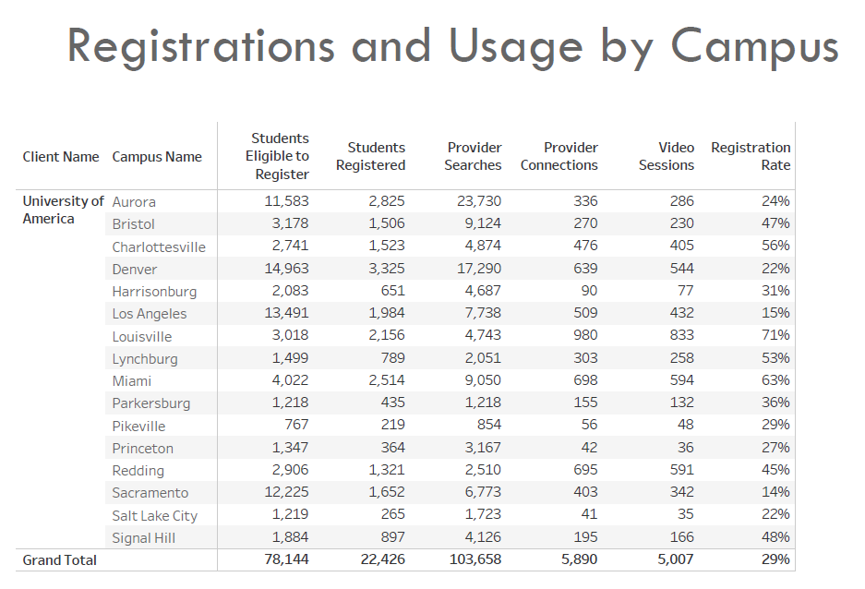
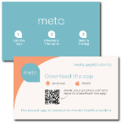
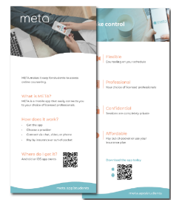
Success Through Student Engagement
Marketing Support
Physical & digital collateral
In-app articles and notifications
Student organization support (campus radio ads, support groups, etc.)
Monthly Reports
De-identified and Aggregated, per HIPAA
Total Registrations & Counseling Sessions
Search & Chat Activity
School-paid sessions for students in-need

Slide 9
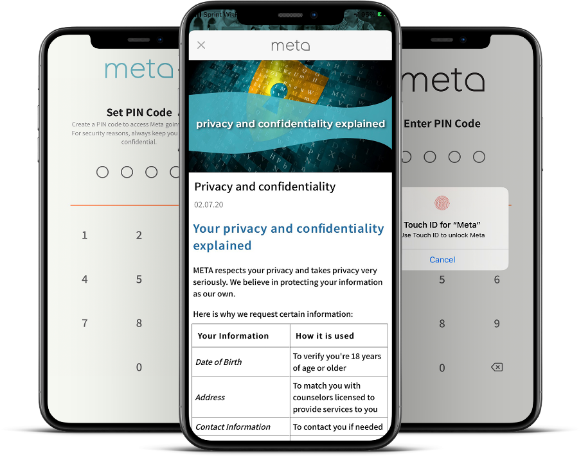
Built for Security, Privacy & Ease of Implementation
HIPAA-compliant, Cloud Based
Student-provider interactions are end-to-end encrypted
App is secured with PIN/Biometrics
PII/PHI is shared only with provider selected by student
Credit/debit card transactions are secured on PCI-DSS compliant systems
Only de-identified aggregated data, allowable legal parameters for PHI
Simple IT Integration & Implementation
Implementation in as little as 3 to 5 days
Just need a list of Eligible Students and Staff

Slide 10
Credibility, Trust: 160 Campuses & Prestigious Organizations
Partnership to provide counseling services using both school counselors and META’s providers to Historically Black Colleges and Universities
“Mental health care has never been more important for our students than it is right now. By partnering with META, we instantly remove many barriers to care that could prevent a student from receiving the therapy they need. META addresses stigmas surrounding mental health assistance and allows students to connect with providers in an easy, private, and safe manner.”
– Dr. Lester Newman, President of Jarvis Christian College
18-month contract through TMCF to make mental health accessible to HBCU students. ECMC foundation is covering unlimited counseling session for undergraduate Pell eligible students in participating institutions
“We serve a diverse student body representing nearly three dozen nations. Because of this, we are proud to work with META, which connects our students to a broad range providers who reflect their cultural background.”
– Dr. Heidi M. Anderson, President of the University of Maryland Eastern Shore
Pilot with College Track, College Beyond and Cowen University’s Upward Bound program in New Orleans. Focusing on students without insurance or facing financial difficulties. This grant pays for access and unlimited counseling sessions
“The META mental wellness program allows students to choose their own counselor and avoid the stigma of anyone knowing they’re in therapy. META’s positive messaging inspires students to consider their emotional health.”
– John K. Pierre, Chancellor of Southern University Law Center
Partnership with Asian & Pacific Islander American Scholars organization to provide access and limited counseling sessions for its member students
"META has strong support with access to providers specializing in all areas of mental health and flexible scheduling options, it seemed like a perfect fit for those in need.”
– Belinda Keiser, Vice Chancellor at Keiser University

Slide 11
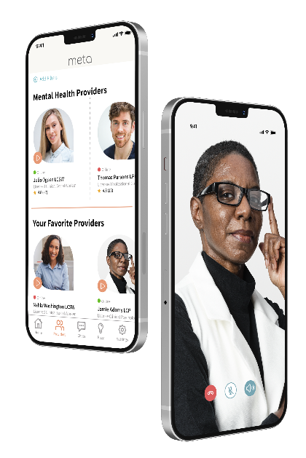
META is Your Ideal Mental Health Partner
Give Students a Service They Will Actually Use – META’s student engagement rate is the best in the industry
No subscription or access fees to students
Sliding scale and hardship rates; insurance plans accepted
Option to offer school-paid sessions for some or all students
User-friendly, private, secure app equally connects all students to counselors
Provide Access to the Best Counselor Network for College Students
Diverse counselors matched to your student demographics are available days, evenings, and weekends and hold a 4.9/5.0 student rating with an average response rate under 6 hours
Include your own counseling staff at no additional chare to provide even more options for students
Join 100s of other schools who have partnered with META!

Slide 12
META is the Right Solution at the Right Time
Solution | Eligible Users | Cost to Users | Scheduling | Counselor Choice | Retention
 | Exclusive for college students | No subscription or access fees. Students pay per session through insurance or out-of-pocket | 7days per week + evening hours based on student preference. Counselors’ average response time is under six hours. | Students can choose their own counselor | Works with school to engage and retain college students
 | Targeted to anyone 18 years or older | Subscription service –with plans ranging from $260 to $400 /month. Insurance is not accepted. | Only available 5 days a week | Users can not choose their own therapist | No special outreach or engagement for college students
 | All individuals, couples, and teens | Subscription service –with plans ranging from $160 to $350 /month. Insurance is not accepted | Sessions are scheduled – can take up to a week for an appointment | Users can not choose their own therapist | No special outreach or engagement for college students

Slide 13
Services and Costs
Annual subscription fee based on number of students and number of campuses
Annual Subscription Includes
Dedicated Client Success Manager
Access to META’s national network of providers aligned to your school’s student demographics
Onboarding of your existing counseling staff to the META app (only visible to your students)
Marketing Kit with Digital and Ready-to-Print Collateral
Ongoing Student Engagement Support and Outreach
Monthly Reporting
Optional Services – School Paid Sessions
School pays only for completed student sessions
Budget-based or Sessions Based
First-come, first-served option or unlimited sessions
All students or pre-identified set of students
Ability to adjust session limits for specific students
HIPAA compliant visibility to session details
Option to report student name subject to student Consent

Slide 14
Questions and Next Steps
Katy Allen, Director
Sri Santhanam, SVP
Rajan@coverpoint.us
(847)452-6794
ssanthanam@meta.app
(224) 227-3568

