Slide 1
META Teletherapy
Mental Health Services Partner for Colleges

Slide 2
The Nation’s Only College Mental Health Marketplace!
EASY, MOBILE ACCESS - The META app is free to download. Students connect to META’s licensed providers or their school’s counselors for chat, voice call and video sessions
RESPONSE TIME IN UNDER SIX HOURS - META providers are available weekdays, evenings, and weekends to all on-campus and remote students. Students can get help when they need, and your counseling staff can focus on sessions and care delivery. 1 in 3 teletherapy sessions occur before 9am and after 5 pm
EXPANDS SCHOOL SUPPORT - META augments your existing healthcare services as a scalable and cost-effective mental health solution

Slide 3
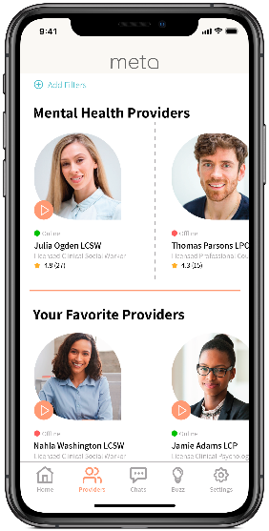
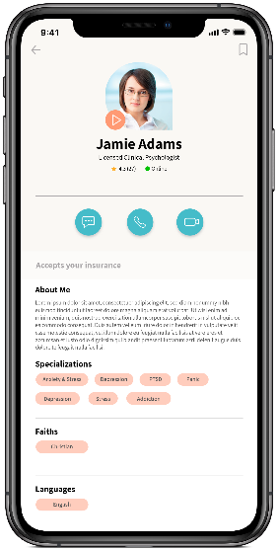
META App is Built for Students Like Yours
SEARCH
SELECT
ENGAGE
Access
Register in 2 minutes
Choice
Select campus or META counselor
Connect
Private chat, video, voice sessions

Slide 4
DEMO

Slide 5
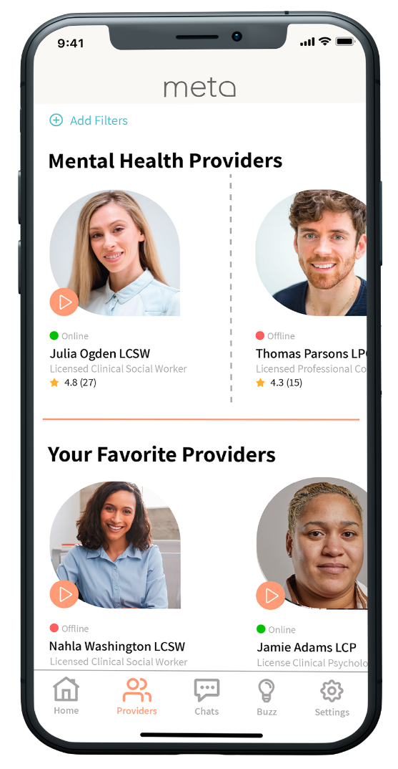
Provider Network Just for Colleges
500+ licensed professional counselors, family therapists, social workers and psychologists
All providers are personally vetted and pass thorough onboarding process
Availability during weekends and evenings; accepting new patients
Additional providers on-boarded to suit college/student needs
Responsive and Committed
Providers log an average of ~4,000 hours of online availability each month
Online providers respond in near-real-time through app
Offline providers are notified via email/text; average response time <6 hours
Average provider rating by students is 4.9/5.0
Provider options suit student needs
Multiple ethnicities, faiths, and languages represented including Black, Native American, Asian and Latino

Slide 6
Stringent Vetting Process for META Providers
Step 1:
IDENTITY CONFIRMATION
Step 2:
BACKGROUND CHECK & LICENSURE VERFICATION
Step 3:
PROFILE REVIEW & QUALITY ASSURANCE
Confirm government ID (driver’s license, state ID, military ID, or passport)
Compare name and photo to profile
Check National Sex Offender Registry for provider’s name
Verify active license is in good standing with Licensing Board for their state
Confirm National Provider Identifier (NPI) matches profile
Final review of META profile:
Education
Practice name
Malpractice insurance
HIPAA and consent forms
Insurance accepted
Payment options & fee schedule
Technical testing and QA

Slide 7
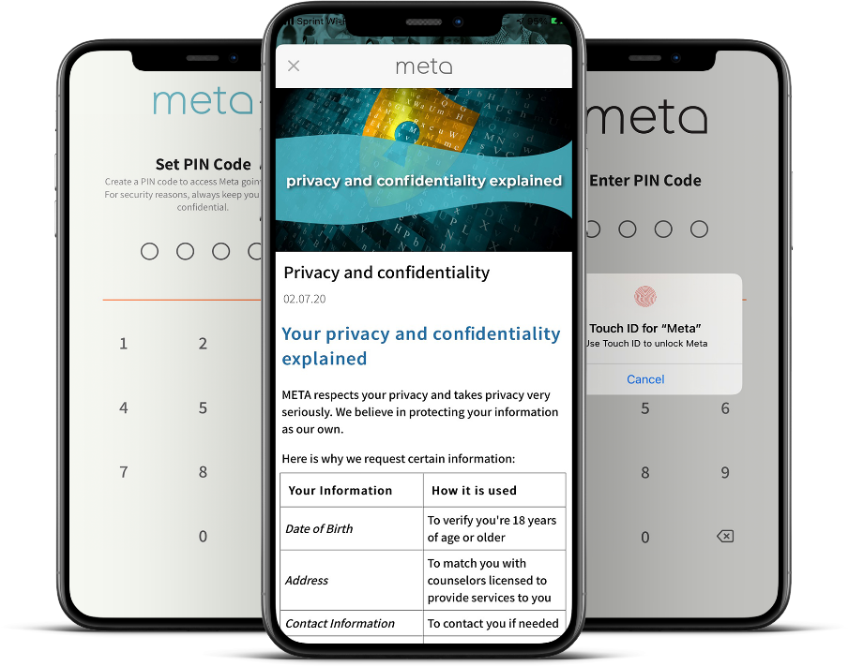
Built for Security, Privacy & Ease of Implementation
HIPAA-compliant, Cloud Based
Student-provider interactions are end-to-end encrypted
App is secured with PIN/Biometrics
PII/PHI is shared only with provider selected by student
Credit/debit card transactions are secured on PCI-DSS compliant systems
Only de-identified aggregated data, allowable legal parameters for PHI
Simple IT Integration & Implementation
Implementation in as little as 3 to 5 days
Just need a list of eligible students

Slide 8
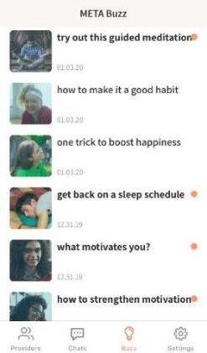
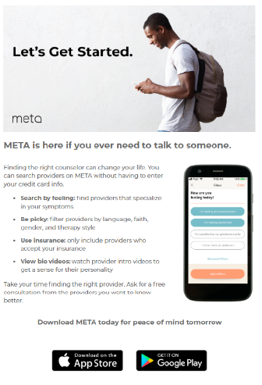
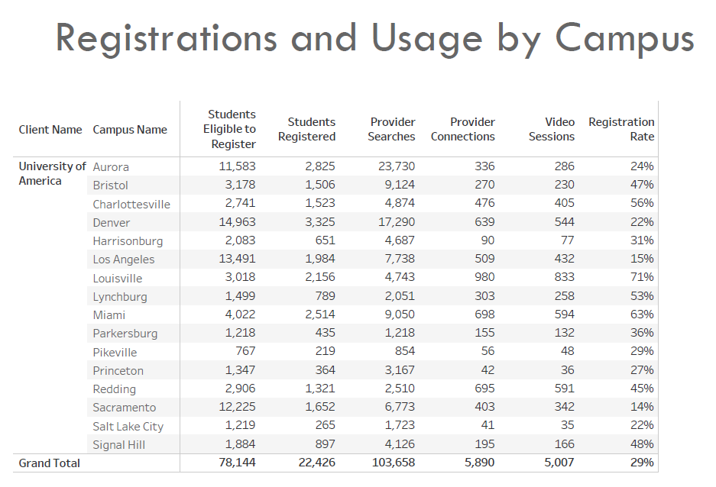
Success Through Student Engagement
Marketing Support
Digital collateral
In-app articles and notifications
Student organization support (campus radio ads, support groups, etc.)
Monthly Reports
De-identified and Aggregated, per HIPAA
Total Registrations & Counseling Sessions
Search & Chat Activity
School-paid sessions for students in-need

Slide 9
Credibility, Trust: 160 Campuses & Prestigious Organizations
Partnership to provide counseling services using both school counselors and META’s providers to Historically Black Colleges and Universities
“Mental health care has never been more important for our students than it is right now. By partnering with META, we instantly remove many barriers to care that could prevent a student from receiving the therapy they need. META addresses stigmas surrounding mental health assistance and allows students to connect with providers in an easy, private, and safe manner.”
– Dr. Lester Newman, President of Jarvis Christian College
18-month contract through TMCF to make mental health accessible to HBCU students. ECMC foundation is covering unlimited counseling session for undergraduate Pell eligible students in participating institutions
“We serve a diverse student body representing nearly three dozen nations. Because of this, we are proud to work with META, which connects our students to a broad range providers who reflect their cultural background.”
– Dr. Heidi M. Anderson, President of the University of Maryland Eastern Shore
Pilot with College Track, College Beyond and Cowen University’s Upward Bound program in New Orleans. Focusing on students without insurance or facing financial difficulties. This grant pays for access and unlimited counseling sessions
“The META mental wellness program allows students to choose their own counselor and avoid the stigma of anyone knowing they’re in therapy. META’s positive messaging inspires students to consider their emotional health.”
– John K. Pierre, Chancellor of Southern University Law Center
Partnership with Asian & Pacific Islander American Scholars organization to provide access and limited counseling sessions for its member students
"META has strong support with access to providers specializing in all areas of mental health and flexible scheduling options, it seemed like a perfect fit for those in need.”
– Belinda Keiser, Vice Chancellor at Keiser University

Slide 10
Simplified Sales Process
The META contract is MHEC approved
Due diligence and legal review completed by MHEC
Standard Pricing, Standard Terms for all colleges
Applicable for institutions in MHEC, NEBHE, WICHE and SREB compact states
Send us an email - sales@meta.app
We will send you the MHEC approved contract
We can do another demo for your executive team if needed
Select your service options, sign and implement in as little as 3 - 5 days

Slide 11
Services and Options
Annual subscription fee based on number of students and number of campuses
Annual Subscription Includes
Dedicated Client Success Manager
Access to META’s national network of providers aligned to your school’s student demographics
Onboarding of your existing counseling staff to the META app (only visible to your students)
Marketing Kit with Digital and Ready-to-Print Collateral
Ongoing Student Engagement Support and Outreach
Monthly Reporting
Optional Services – School Paid Sessions
School pays only for completed student sessions
Budget-based or Sessions Based
First-come, first-served option or unlimited sessions
All students or pre-identified set of students
Ability to adjust session limits for specific students
HIPAA compliant visibility to session details
Option to report student name subject to student Consent

Slide 12
Schools in MHEC and Sister Compact States Receive…
Skip the sales process – MHEC has negotiated on your behalf
Pre-negotiated rates and contract approved by MHEC
Quick implementation – easily launch in less than a week
Eligible Population | # of Campuses | MHEC Annual Sponsorship Fee
Under 2,000 | Single Campus | $7,000
 | Multiple Campuses | $7,000 + $2,000/campus
2,001 - 4,000 | Single Campus | $12,000
 | Multiple Campuses | $12,000 + $2,000/campus
More than 4,000 | Single Campus | $20,000
 | Multiple Campuses | $25,000 + $2,000/campus

Slide 13
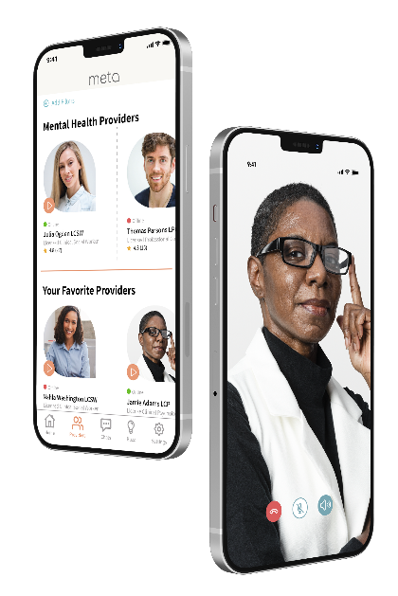
META is Your Ideal Student Wellness Partner
Give Students a Service They Will Actually Use – META’s student engagement rate is the best in the industry
No subscription or access fees to students
Sliding scale and hardship rates; insurance plans accepted
Option to offer school-paid sessions for some or all students
Provide Access to the Best Counselor Network for College Students
Counselors matched to your student demographics are available days, evenings, and weekends
Include your own counseling staff at no additional charge to provide even more options for students

Slide 14
Questions and Next Steps
Katy Allen, META Director
kallen@meta.app (630) 673-3920
Sri Santhanam, META SVP
ssanthanam@meta.app (224) 227-3568
Jennifer Dahlquist, MHEC Vice President
jenniferd@mhec.org
(612) 677-2762

Slide 15
Appendix

Slide 16
Meet Your Presenters
Jennifer Dahlquist
Katy Allen
Sri Santhanam
MHEC VP
META Director
META SVP

Slide 17
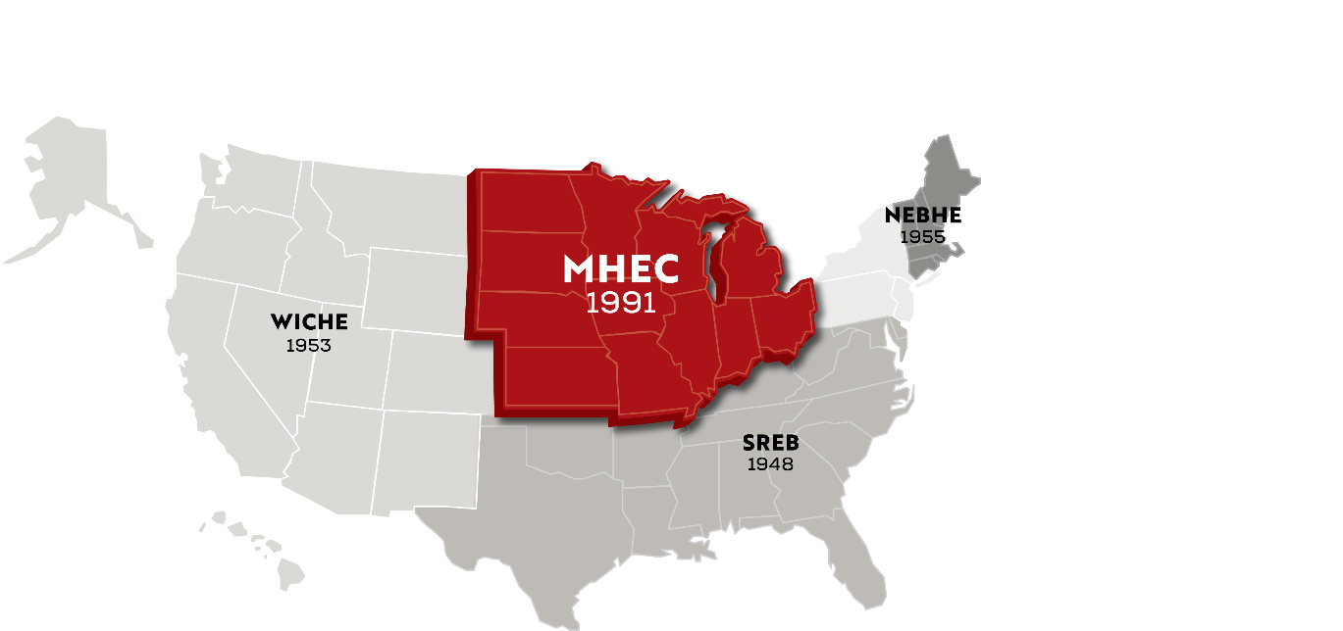
About MHEC
Midwestern Higher Education Compact (MHEC) was legislatively created and serves the Midwest census region (12 states)
Governed by 60 commissioners plus commissioner alternates
One of four regional higher education compacts (MHEC, WICHE, SREB, NEBHE)
MHEC brings together midwestern states to develop and support best practices, collaborative efforts, and cost-sharing opportunities. Through these efforts it works to ensure strong, equitable postsecondary educational opportunities and outcomes for all.
Notes:
The Midwestern Higher Education Compact headquartered in Minneapolis also known as MHEC (mek) or M-H-E-C
New England Board of Higher Education headquartered in Boston
Southern Regional Education Board headquartered in Atlanta
The Western Interstate Commission for Higher Education in Boulder

Slide 18
MHECare Student Insurance Solutions Program
MHECare was established through requests from key higher education and legislative leaders seeking a collaborative region-wide approach to supporting student health and wellness
Led by MHEC’s Student Health Benefits Advisory Committee consisting of a wide cross section of experts in student health care
Explores regional initiatives to improve higher education productivity for colleges and universities facing increasing demands for student health care
Programmatic options for fully-insured school-sponsored health plans and now virtual mental health services

Slide 19
Program with META Teletherapy
According to a recent ACHA and Healthy Minds survey, The Impact of COVID-19 on College Student Well-Being, 60% of students indicate that the pandemic has made it more difficult to access mental health care
Competitively bid through an RFP led by the Student Health Benefits Advisory Committee
All higher education institutions within the MHEC, NEBHE, SREB and WICHE regions, both public and private not-for-profit, are eligible to utilize this program
Notes:
With that, I'm going to turn the presentation over to Sri and Katy with META Teletherapy.

Slide 20
Why Partner with META Teletherapy?
META’s Experience
META was created based on 15 years of experience working with over 1,000 campuses across the US
Built for Security, Privacy & Ease of Implementation and Use
META’s Provider Network
META provides the best counselor-to-student ratio and matches your student demographics
Providers in all 50 states, student rating of providers is 4.9/5.0
Providers have an average response time under six hours (industry average is 1-3 days)
META’s Reputation
META has the endorsement from prestigious non-profit organizations such as the Thurgood Marshall College Fund, APIA Scholars, ECMC Foundation, and Kresge Foundation that are dedicated to expanding mental health access to underserved populations
70 campuses have partnered with META in the last 18 months

Slide 21
COVID has Detrimentally Impacted the College Experience
60 percent of students indicate that the pandemic has made it more difficult to access mental health care | 66 percent of students reported that the pandemic has resulted in more financial stress
46 percent of at-risk students taking online courses reported greater mental health needs | 63 percent of students would grade their college’s response to mental health and wellness services a “C” or lower
Health Minds Network & ACHA “The Impact of COVID-19 on College Student Well-Being”
“Students Struggle but Don’t Seek Colleges’ Help,” Inside Higher Education

Slide 22
Expand Mental Health Access to Your Students This Fall
Our Goal: Partner with you to augment your existing student mental health services as it benefits your academic mission and economic well-being
Young adults aged 18 – 25 have the highest prevalence of serious mental illness
Over half of students who seriously consider suicide never receive professional help
COVID related events have placed a huge burden on students
Stigma is still a barrier, especially for students of color, first-generation, LGBTQ+, and other minorities
Students suffering from symptoms of mental health disorders are at risk of lower GPA, discontinuous enrollment, and dropping out
Students are looking for mental health support all week, not just 9am-5pm on weekdays
At META, we address these challenges and eliminate the barriers preventing college students from accessing care
Notes:
https://www.nimh.nih.gov/health/statistics/mental-illness
https://www.ncbi.nlm.nih.gov/pmc/articles/PMC3788673/

Slide 23
META Providers Adapt to Students’ Schedules

