Slide 1
META Teletherapy
Mental Health Services Partner for Colleges

Slide 2




COVID has Detrimentally Impacted the College Experience
60 percent of students indicate that the pandemic has made it more difficult to access mental health care | 66 percent of students reported that the pandemic has resulted in more financial stress
46 percent of at-risk students taking online courses reported greater mental health needs | 63 percent of students would grade their college’s response to mental health and wellness services a “C” or lower
Health Minds Network & ACHA “The Impact of COVID-19 on College Student Well-Being”
“Students Struggle but Don’t Seek Colleges’ Help,” Inside Higher Education

Slide 3


The Nation’s Only College Mental Health Marketplace!
EASY, MOBILE ACCESS - The META app is free to download. Students connect to META’s licensed providers or their school’s counselors for chat, voice call and video sessions
RESPONSE TIME IN UNDER SIX HOURS - META providers are available weekdays, evenings, and weekends to all on-campus and remote students. Students can get help when they need, and your counseling staff can focus on sessions and care delivery. 1 in 3 teletherapy sessions occur before 9am and after 5 pm
EXPANDS SCHOOL SUPPORT - META augments your existing healthcare services as a scalable and cost-effective mental health solution

Slide 4

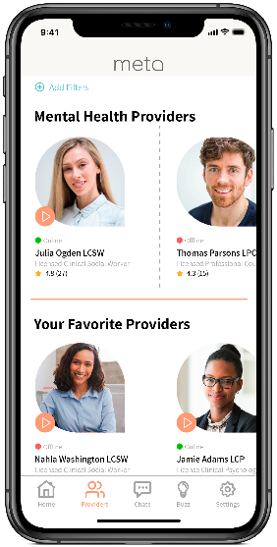
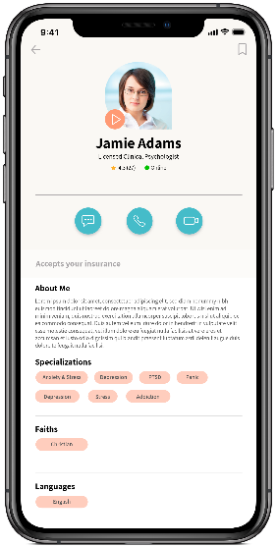
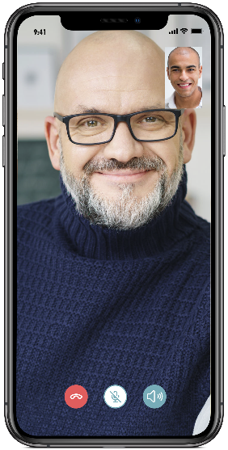


META App is Built for Students Like Yours
SEARCH
SELECT
ENGAGE
Access
Register in 2 minutes
Choice
Select campus or META counselor
Connect
Private chat, video, voice sessions

Slide 5

DEMO

Slide 6
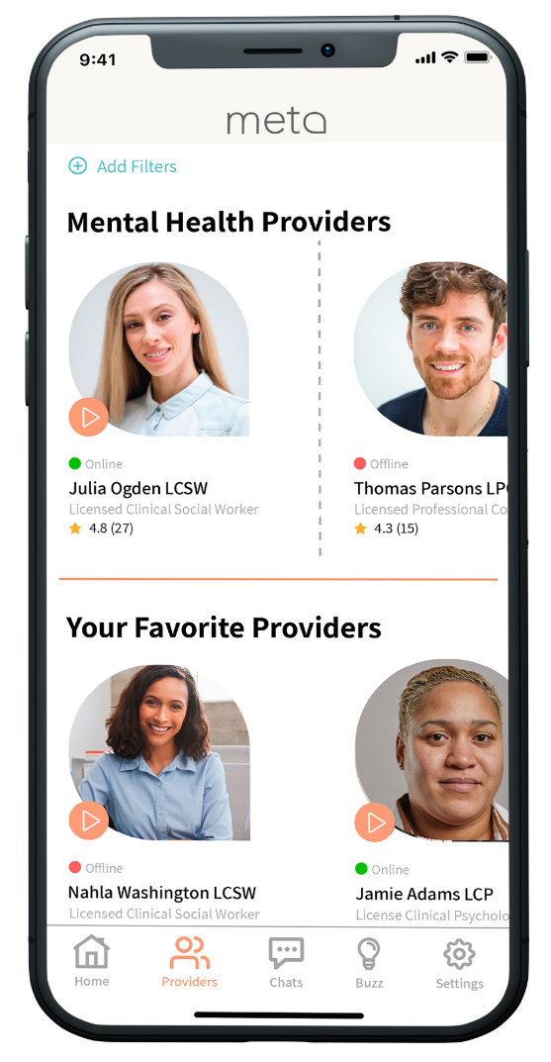
Provider Network Just for Colleges
500+ licensed professional counselors, family therapists,
social workers and psychologists
All providers are personally vetted and pass thorough onboarding process
Availability during weekends and evenings; accepting new patients
Additional providers on-boarded to suit college/student needs
Responsive and Committed
Providers log an average of ~4,000 hours of online availability each month
Online providers respond in near-real-time through app
Offline providers are notified via email/text; average response time <6 hours
Average provider rating by students is 4.9/5.0
Provider options suit student needs
Multiple ethnicities, faiths, and languages represented including Black, Native American, Asian and Latino

Slide 7



Stringent Vetting Process for META Providers
Step 1:
IDENTITY
CONFIRMATION
Step 2:
BACKGROUND CHECK &
LICENSURE VERFICATION
Step 3:
PROFILE REVIEW &
QUALITY ASSURANCE
Confirm government ID (driver’s license, state ID, military ID, or passport)
Compare name and photo to profile
Check National Sex Offender Registry for provider’s name
Verify active license is in good standing with Licensing Board for their state
Confirm National Provider Identifier (NPI) matches profile
Final review of META profile:
Education
Practice name
Malpractice insurance
HIPAA and consent forms
Insurance accepted
Payment options & fee schedule
Technical testing and QA

Slide 8
META Providers Adapt to Students’ Schedules

Slide 9
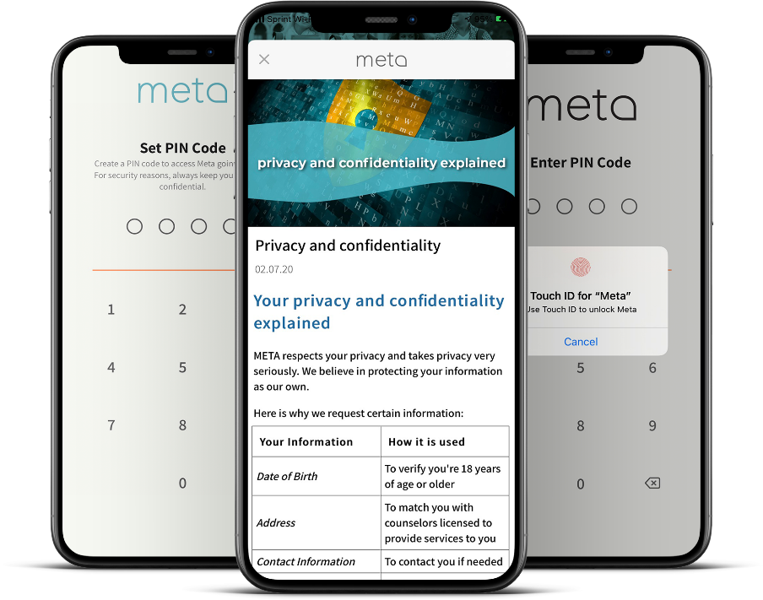
Built for Security, Privacy & Ease of Implementation
HIPAA-compliant, Cloud Based
Student-provider interactions are end-to-end encrypted
App is secured with PIN/Biometrics
PII/PHI is shared only with provider selected by student
Credit/debit card transactions are secured on PCI-DSS compliant systems
Only de-identified aggregated data, allowable legal parameters for PHI
Simple IT Integration & Implementation
Implementation in as little as 3 to 5 days
Just need a list of eligible students

Slide 10

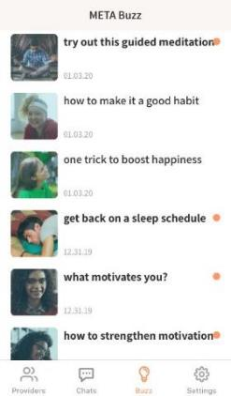
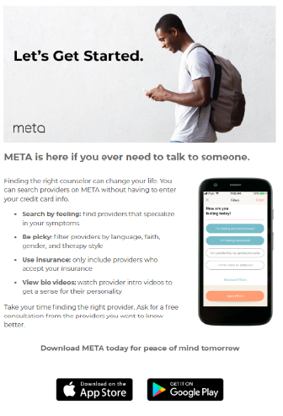
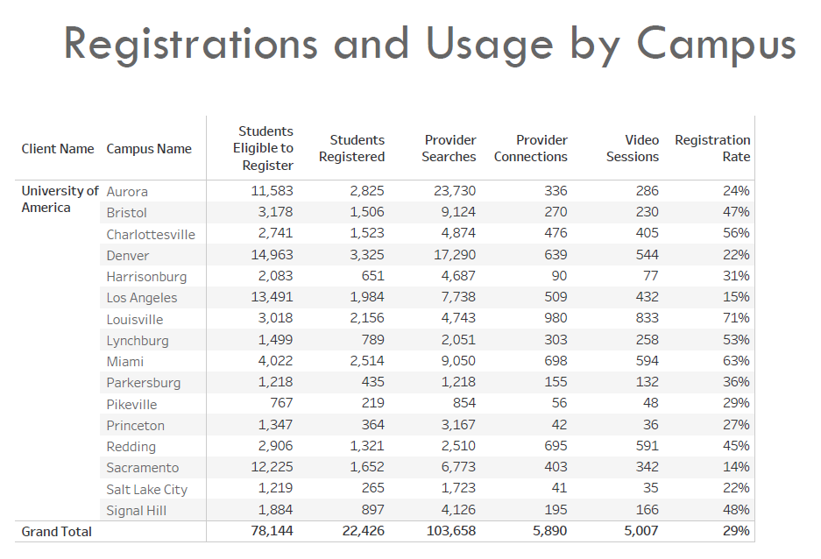
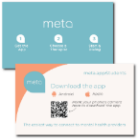


Success Through Student Engagement
Marketing Support
Physical & digital collateral
In-app articles and notifications
Student organization support (campus radio ads, support groups, etc.)
Monthly Reports
De-identified and Aggregated, per HIPAA
Total Registrations & Counseling Sessions
Search & Chat Activity
School-paid sessions for students in-need

Slide 11








Credibility, Trust: 160 Campuses & Prestigious Organizations
Partnership to provide counseling services using both school counselors and META’s providers to Historically Black Colleges and Universities
“Mental health care has never been more important for our students than it is right now. By partnering with META, we instantly remove many barriers to care that could prevent a student from receiving the therapy they need. META addresses stigmas surrounding mental health assistance and allows students to connect with providers in an easy, private, and safe manner.”
– Dr. Lester Newman,
President of Jarvis Christian College
18-month contract through TMCF to make mental health accessible to HBCU students. ECMC foundation is covering unlimited counseling session for undergraduate Pell eligible students in participating institutions
“We serve a diverse student body representing nearly three dozen nations. Because of this, we are proud to work with META, which connects our students to a broad range providers who reflect their cultural background.”
– Dr. Heidi M. Anderson,
President of the University of Maryland Eastern Shore
Pilot with College Track, College Beyond and Cowen University’s Upward Bound program in New Orleans. Focusing on students without insurance or facing financial difficulties. This grant pays for access and unlimited counseling sessions
“The META mental wellness program allows students to choose their own counselor and avoid the stigma of anyone knowing they’re in therapy. META’s positive messaging inspires students to consider their emotional health.”
– John K. Pierre,
Chancellor of Southern University Law Center
Partnership with Asian & Pacific Islander American Scholars organization to provide access and limited counseling sessions for its member students
"META has strong support with access to providers specializing in all areas of mental health and flexible scheduling options, it seemed like a perfect fit for those in need.”
– Belinda Keiser,
Vice Chancellor at Keiser University

Slide 12
Services and Options
Annual subscription fee based on number of students and number of campuses
Annual Subscription Includes
Dedicated Client Success Manager
Access to META’s national network of providers aligned to your school’s student demographics
Onboarding of your existing counseling staff to the META app (only visible to your students)
Marketing Kit with Digital and Ready-to-Print Collateral
Ongoing Student Engagement Support and Outreach
Monthly Reporting
Optional Services – School Paid Sessions
School pays only for completed student sessions
Budget-based or Sessions Based
First-come, first-served option or unlimited sessions
All students or pre-identified set of students
Ability to adjust session limits for specific students
HIPAA compliant visibility to session details
Option to report student name subject to student Consent

Slide 13
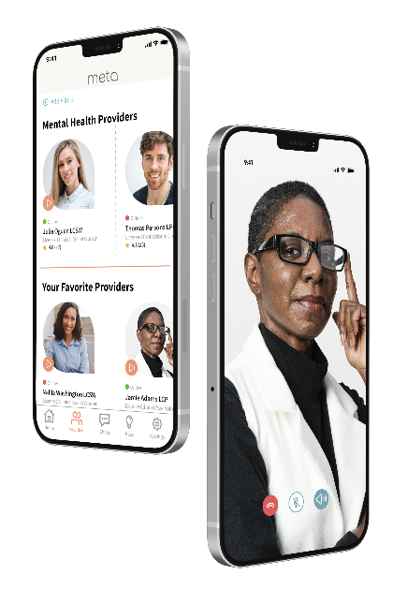
META is Your Ideal Student Wellness Partner
Give Students a Service They Will Actually Use
– META’s student engagement rate is the best in the industry
No subscription or access fees to students
Sliding scale and hardship rates; insurance plans accepted
Option to offer school-paid sessions for some or all students
Provide Access to the Best Counselor Network for College Students
Counselors matched to your student demographics are available days, evenings, and weekends
Include your own counseling staff at no additional charge to provide even more options for students

Slide 14

Questions and Next Steps
Katy Allen, META Director
kallen@meta.app (630) 673-3920
Sri Santhanam, META SVP
ssanthanam@meta.app (224) 227-3568
Jennifer Dahlquist, MHEC Vice President
jenniferd@mhec.org
(612) 677-2762

